Slide 1
Nearly Optimal Robust Matrix Completion
Yeshwanth Cherapanamjeri, Kartik Gupta and Prateek Jain
Microsoft Research India
Notes:
Hello everyone, I will be discussing my recent work on Robust Matrix Completion done with Yeshwanth Cherapanamjeri and Prateek Jain at Microsoft Research India.

Slide 2
Outline
Robust Matrix Completion
Problem Definition
Motivating Applications
Algorithm
Theoretical Results
Empirical Results
Summary & Future Work
Notes:
The talk is structured as follows: I will start with the problem definition and motivate it with some important applications. Then I will outline the algorithm that we propose and discuss the theoretical guarantees that we obtain. Following that I will discuss the empirical performance of our method and then wrap up the talk with a brief discussion of what

Slide 3
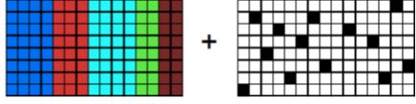
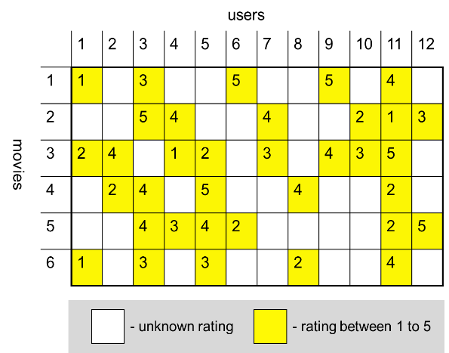
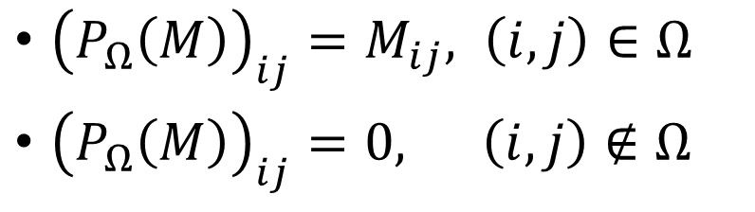
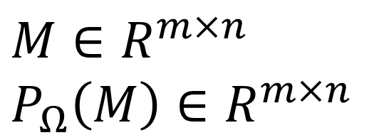
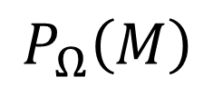

Robust Matrix Completion
$$≈$$
$$M ≈ L^{∗} + S^{∗}$$
GOAL: Decompose $M$ as a sum of a low-rank $(L^{∗})$ and a sparse matrix ($S^{∗}$)
$$M∈R^{m×n}$$
$$P_{Ω}\left(M\right)∈R^{m×n}$$
${\left(P_{Ω}\left(M\right)\right)}_{ij}=M_{ij}, \left(i,j\right)∈Ω$
${\left(P_{Ω}\left(M\right)\right)}_{ij}=0, \left(i,j\right)∉Ω$
$$P_{Ω}\left(M\right)$$

Slide 4
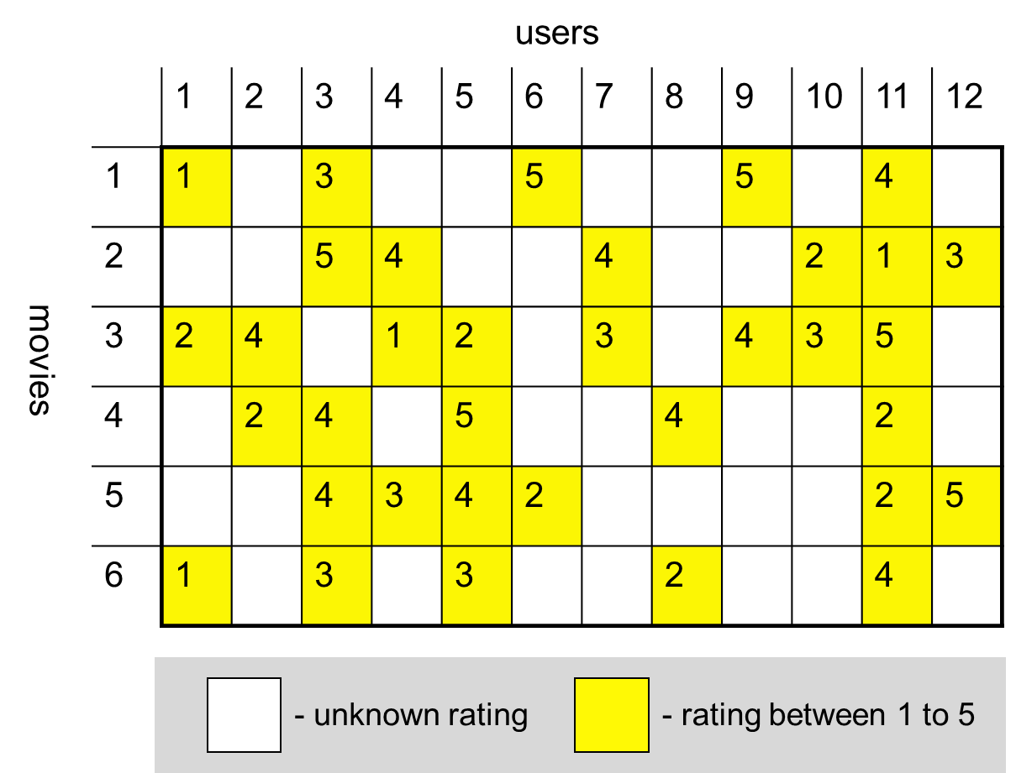
Motivating Application 1: Robust Recommender System
Aberrations/Outliers
Random aberrations
Adversarial outliers: merchant tries to bias ratings towards his products

Slide 5
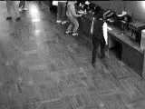
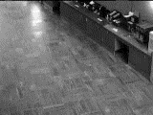
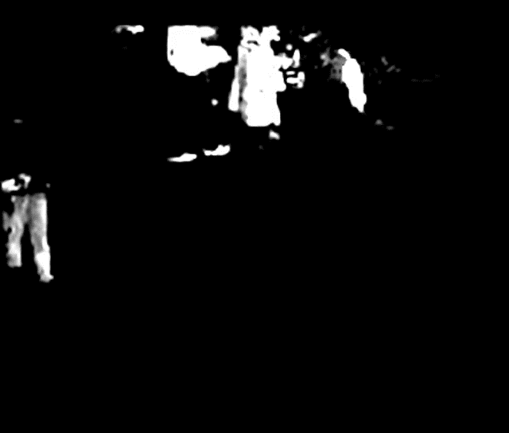
Motivating Application 2: Background Extraction
=
+
Background
Sparse Foreground
Notes:
Another motivating example is that of background extraction. Here we assume that the foreground is sparse and assume it

Slide 6
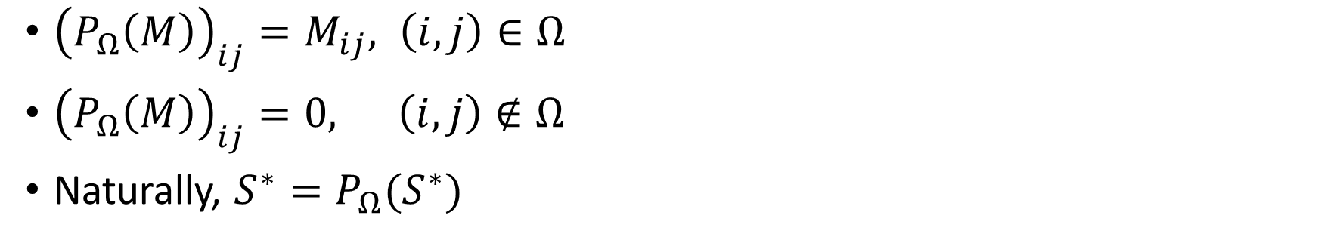
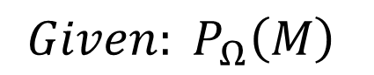
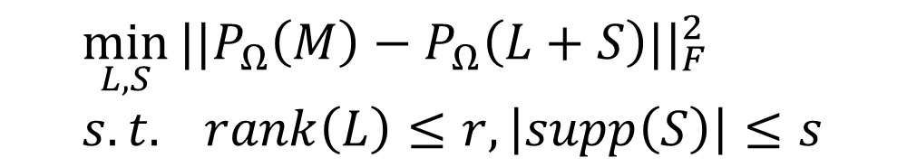
Robust Matrix Completion
n
n
$$Given: P_{Ω}\left(M\right)$$
$$M ≈ L^{∗} + S^{∗}$$
$$\min_{L, S}{||P_{Ω}\left(M\right)−P_{Ω}\left(L+S\right)||_{F}^{2}} \\ s.t. rank\left(L\right)≤r, \left|supp\left(S\right)\right|≤s$$
${\left(P_{Ω}\left(M\right)\right)}_{ij}=M_{ij}, \left(i,j\right)∈Ω$
${\left(P_{Ω}\left(M\right)\right)}_{ij}=0, \left(i,j\right)∉Ω$
Naturally, $S^{∗}=P_{Ω}(S^{∗})$
Non-convex Sets

Slide 7
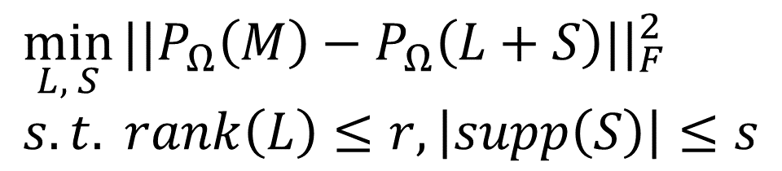
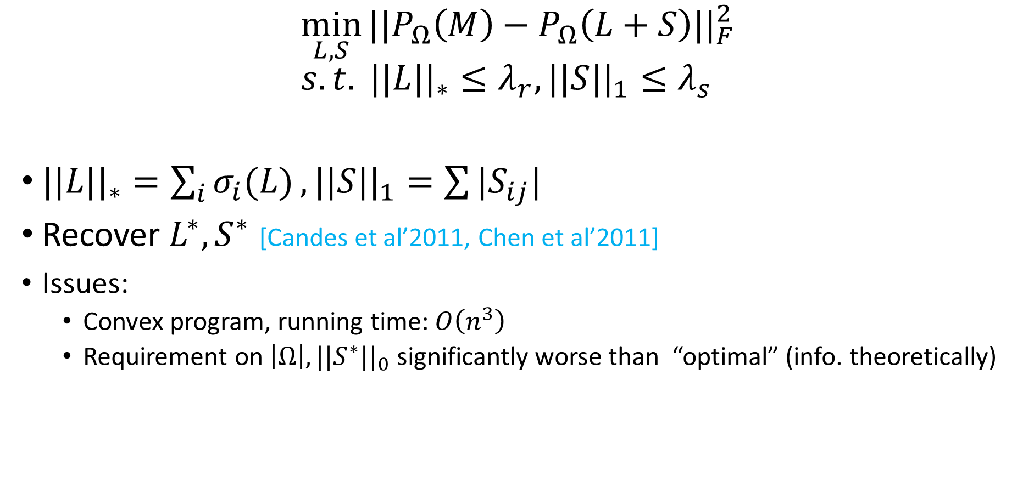
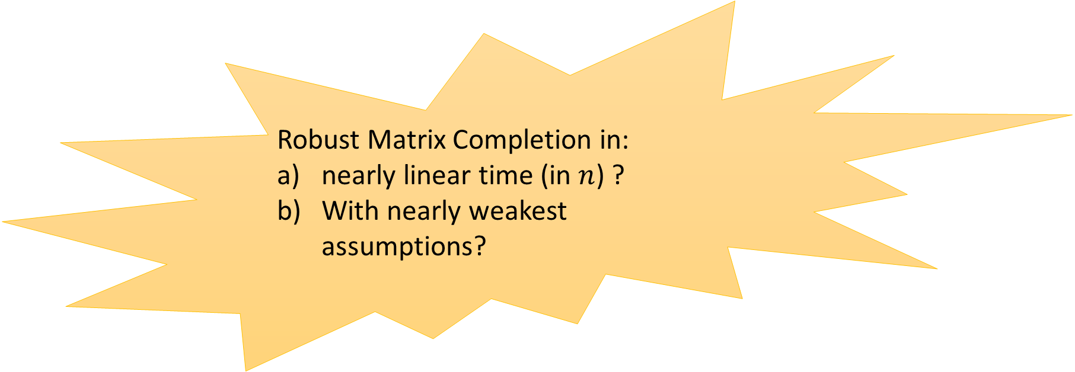
Existing Method
$$\min_{L, S}{||P_{Ω}\left(M\right)−P_{Ω}\left(L+S\right)||_{F}^{2}} \\ s.t. rank\left(L\right)≤r, \left|supp\left(S\right)\right|≤s$$
$$\min_{L, S}{||P_{Ω}\left(M\right)−P_{Ω}\left(L+S\right)||_{F}^{2}} \\ s.t. ||L||_{∗}≤λ_{r}, ||S||_{1}≤λ_{s}$$
$||L||_{∗}=\sum_{i}{σ_{i}(L)}, ||S||_{1}=\sum{|S_{ij}|}$
Recover $L^{∗}, S^{∗}$ [Candes et al’2011, Chen et al’2011]
Issues:
Convex program, running time: $O\left(n^{3}\right)$
Requirement on $\left|Ω\right|, ||S^{∗}||_{0}$ significantly worse than “optimal” (info. theoretically)
Robust Matrix Completion in:
nearly linear time (in $n$) ?
With nearly weakest assumptions?

Slide 8
Our Contribution
Simple algorithm that runs in nearly optimal time
Based on simple proj. grad. method with projection on non-convex set
Scales well to very large problems
Provable convergence to Global Optima in Linear time
Randomness in observations
But allows adversarial corruptions

Slide 9
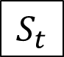
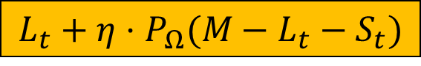
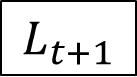
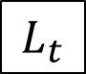
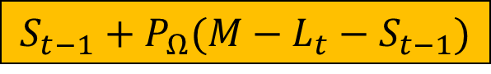
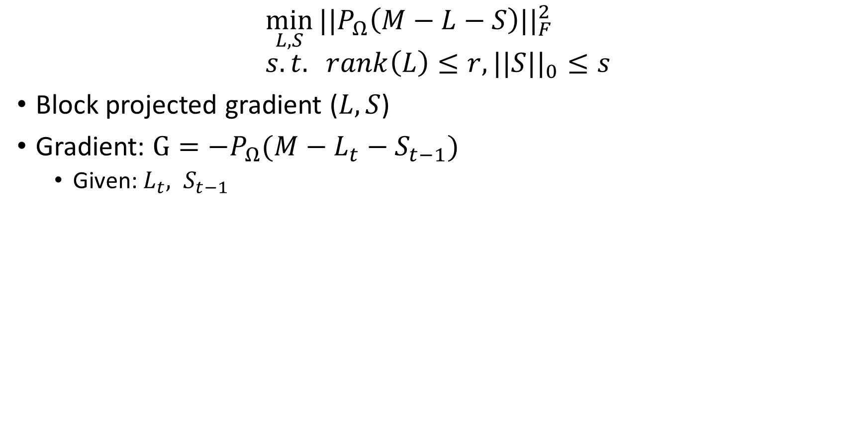
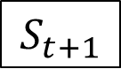
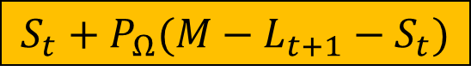
Our Approach: Projected Gradient Descent
$$\min_{L, S}{||P_{Ω}\left(M−L−S\right)||_{F}^{2}} \\ s.t. rank\left(L\right)≤r, ||S||_{0}≤s$$
Block projected gradient ($L, S$)
Gradient: $G=−P_{Ω}(M−L_{t}−S_{t−1})$
Given: $L_{t}, S_{t−1}$
$$L_{t}$$
$$S_{t−1}+P_{Ω}(M−L_{t}−S_{t−1})$$
Hard Thresholding
$$S_{t}$$
$$L_{t}+η⋅P_{Ω}(M−L_{t}−S_{t})$$
PCA
$$L_{t+1}$$
$$S_{t}+P_{Ω}(M−L_{t+1}−S_{t})$$
Hard Thresholding
$$S_{t+1}$$
Low-rank Matrices
Sparse Matrices

Slide 10
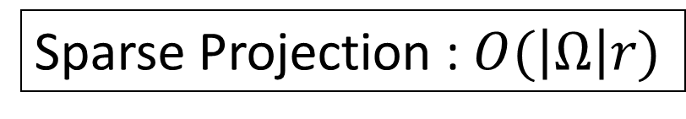
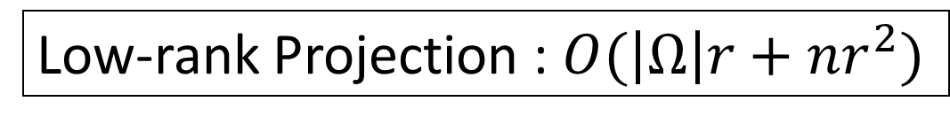
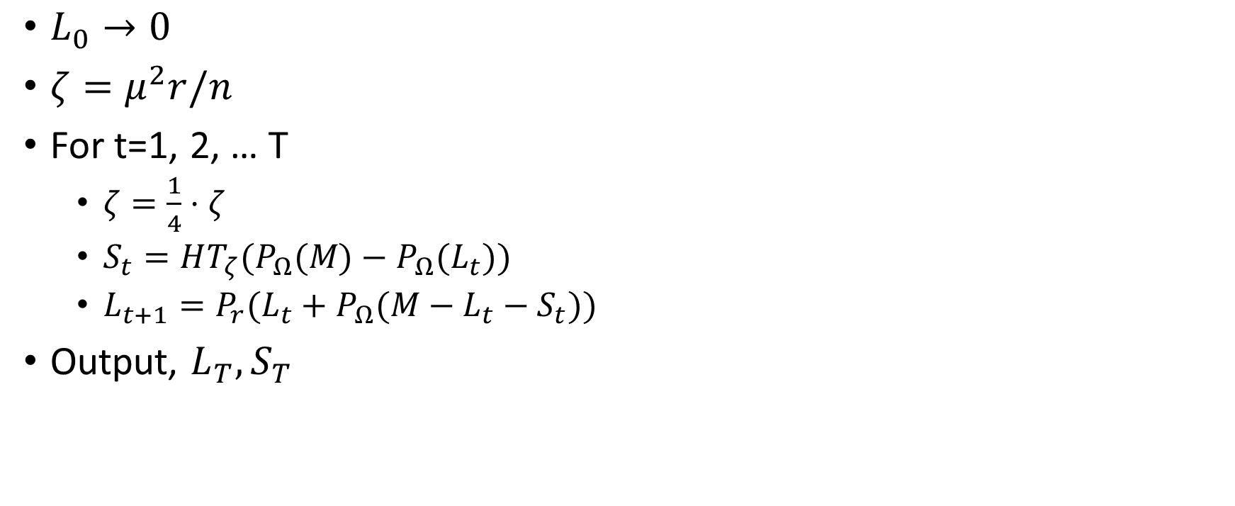

Non-convex RMC
Time Complexity
Linear in the number of observations!
$L_{0}→0$
$ζ=μ^{2}r/n$
For t=1, 2, … T
$ζ=\frac{1}{4}⋅ζ$
$S_{t}=HT_{ζ}(P_{Ω}(M)−P_{Ω}(L_{t}))$
$L_{t+1}=P_{r}(L_{t}+P_{Ω}(M−L_{t}−S_{t}))$
Output, $L_{T}, S_{T}$
Sparse Projection : $O(\left|Ω\right|r)$
Low-rank Projection : $O(\left|Ω\right|r+nr^{2})$
Hard Thresholding
Top $r$ components of the PCA

Slide 11
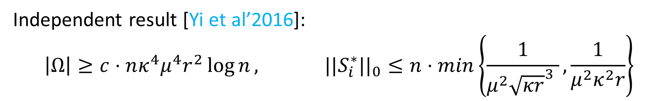
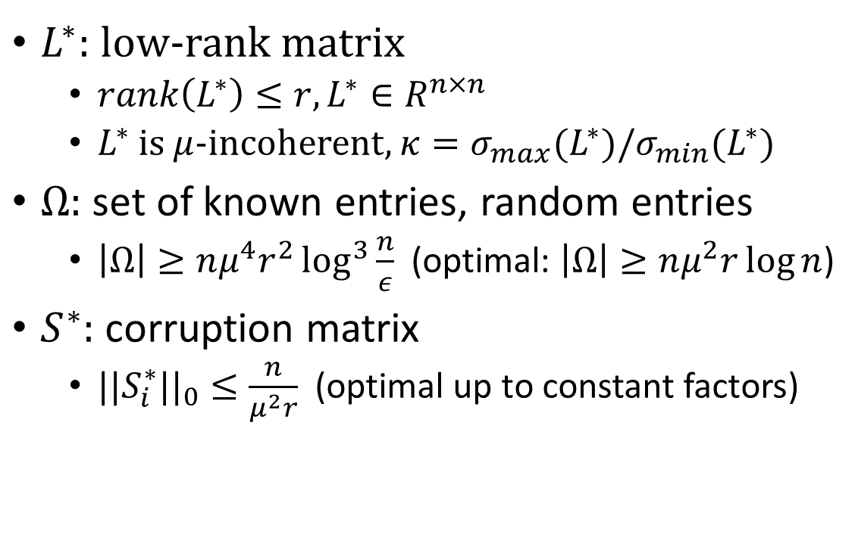
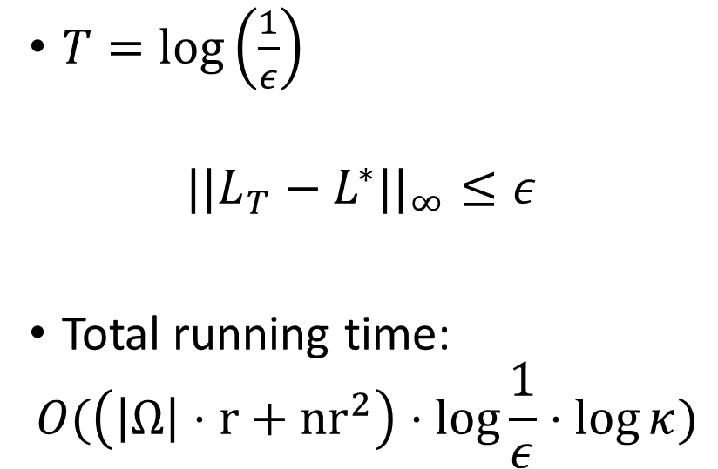
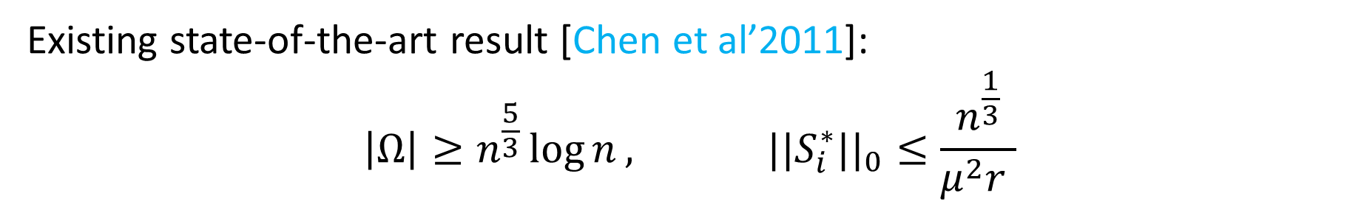
Main Result
Assumptions
Result [CGJ-ICML’17]
$L^{∗}:$ low-rank matrix
$rank\left(L^{∗}\right)≤r, L^{∗}∈R^{n×n}$
$L^{∗}$ is $μ$-incoherent, $κ=σ_{max}(L^{∗})/σ_{min}(L^{∗})$
$Ω:$ set of known entries, random entries
$\left|Ω\right|≥nμ^{4}r^{2}\log^{3}{\frac{n}{ε}}$ (optimal: $\left|Ω\right|≥nμ^{2}r\log{n}$)
$S^{∗}:$ corruption matrix
$||S_{i}^{∗}||_{0}≤\frac{n}{μ^{2}r}$ (optimal up to constant factors)
$T=\log\left(\frac{1}{ε}\right)$
$$||L_{T}−L^{∗}||_{∞}≤ε$$
Total running time:
$$O(\left(\left|Ω\right|⋅r+{nr}^{2}\right)⋅\log{\frac{1}{ε}}⋅\log{κ})$$
Independent result [Yi et al’2016]:
$$\left|Ω\right|≥c⋅nκ^{4}μ^{4}r^{2}\log{n}, ||S_{i}^{∗}||_{0}≤n⋅min\left\{\frac{1}{μ^{2}{\sqrt{κr}}^{3} },\frac{1}{μ^{2}κ^{2}r}\right\}$$
Existing state-of-the-art result [Chen et al’2011]:
$$\left|Ω\right|≥n^{\frac{5}{3}}\log{n}, ||S_{i}^{∗}||_{0}≤\frac{n^{\frac{1}{3}}}{μ^{2}r }$$

Slide 12
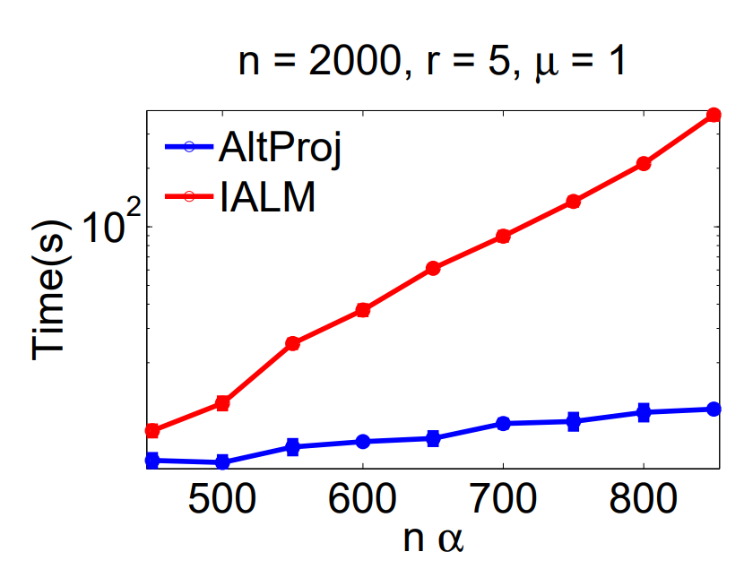
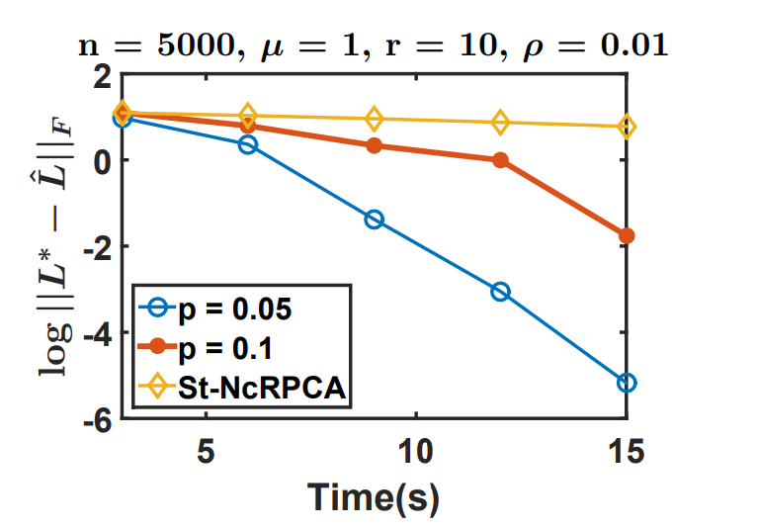

Empirical Results (Synthetic Datasets)
Our Method

Slide 13
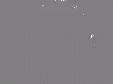

Empirical Results
Our New Non-Convex Method Runtime: 8 sec
=
+
Our Method
Foreground Extraction methods from Open CV
Runtime: 6 sec, 4 sec

Slide 14
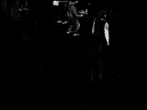
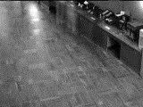
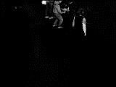
Empirical Results
Convex Method Runtime: 1700 sec
=
+
Non-Convex Method [NUSAJ-NIPS’14] Runtime: 28 sec
=
+

Slide 15
Summary
Robust Matrix Completion
Low-rank+Sparse Decomposition with Missing Entries
Projected Gradient Based Method to solve Robust Matrix Completion
Almost linear convergence rate under standard assumption
Near optimal run-time, sample complexity, number of corruptions
Future Directions
Exploit more information about the corruption
Corruptions are zero mean with random support?
General Problem: learning in high-dimensions
Design algorithms that are robust to outliers/corruptions
General theory of provable non-convex optimization

Slide 16
Questions?

